Slide 1
PPT for the summary of the company. By Ayushma Paudel, student id: 48708453

Slide 2
Analysis of the startup’s performance using financial and media data over time.

Slide 3
Dataset overview Tracks data of company’s performance including: Payroll Revenue Scandals Media coverage

Slide 4
Revenue forecasting Following models are used for the revenue forecasting: a. Regression modeling b. exponential modeling

Slide 5
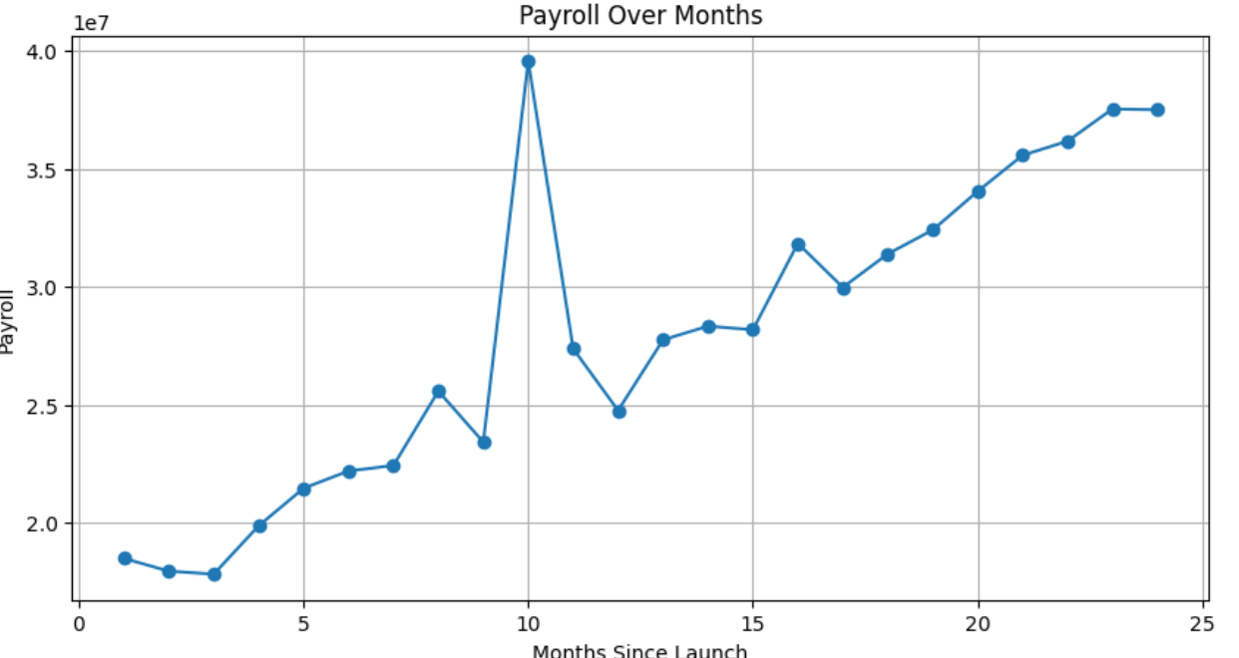
One year analysis Revenue rising moderately Payroll remains stable Media coverage begin shifting more positive but with the probability of remaining negative sentiment still needs attention

Slide 6
Recommendation
It assumes consistent market condition and ignores external factors like competition or economic downturns.
Unrealistic exponential forecast.
Copping with the growth rates to make projection more grounded

Slide 7
THANK YOU FOR YOUR TIME

